Slide 1
Minimum velocity for Viscoelastic surfactant foam in porous media
Aarthi Muthuswamy
Maura Puerto
Rafael Verduzco
Clarence Miller
George Hirasaki
17th Annual Process in Porous media Consortium
April 29th , 2013

Slide 2
Outline
Behavior of 0.5 wt% Rhodia-A in Sea water at standard conditions:
    Viscosity
        Rheometer vs. Single phase flow in sand pack
    N₂Foam as a function of
      Quality and flow rate
      Superficial velocity at ~ 80% quality
    N₂Foam in the presence of oil
    Regime of Weak/Strong Foam
      Minimum Pressure Gradient
      Minimum Superficial Velocity.

Slide 3
I. Rheology – 0.5 wt% Rhodia-A Sea water
Crossover
Viscoelastic
Relaxation time = 0.026 seconds
Notes:
When G’ crosses over G” it is indicative of a viscoelastic fluid. The inverse of the cross over frequency, gives a relaxation time. Here is it 0.026 seconds.

Slide 4




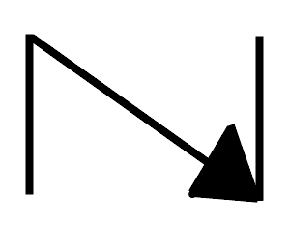
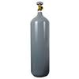

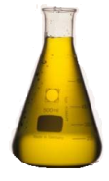

Schematic of Set Up to Study Foam Behavior
Sand: US silica 20-40
Porosity = 0.36
Permeability ~100 Darcy
Inverted burette with 1:1_IPA:Water
Outlet
Measuring
Gas/Liquid
Inlet
Co-Injection
Taps
Taps
Pressure Transducer
Collecting only Liquid
-
+
+
-
+
-
Surfactant Pump
N₂
Mass-Flow Controller
Check valve

Slide 5
II. Procedure- Foam experiments
Sand Pack filled with 20-40 mesh US-silica sand, which was previously sifted, washed and dried
Vacuum to remove air.
    Sand Pack, when isolated from vacuum pump, must hold vacuum to ensure no leaks
Water saturate
    Measure Pore Volume and permeability (~ 100 Darcy)
4. Flood with several PV of 0.5 wt% surfactant in sea water to satisfy adsorption.
    Nitrogen and surfactant are co- injected to generate foam
    Pressure behavior is constantly monitored
    Gas/liquid is measured at certain intervals.
5. At the end of each foam test, inject 6-8 PV of 1:1_ Iso-Propyl Alcohol and water to “kill” the foam.
6. Inject 8-10 PV of plain water to remove IPA from Pack
    7. Pack is flooded again with surfactant solution for about 2 PV
8. Repeat from step 3

Slide 6

Flow test with only Surfactant Solution to determine if by itself surfactant generates high viscosity and hence high pressure drop
Overall
IN
OUT
6”
6”
6”
6”
Tap 1 Tap 2
José Lopez Consortium, 2012
Apparent viscosity, calculated from differential pressures at internal-taps, matches rheometer data.

Slide 7
II. Behavior of 0.5 wt% Rhodia-A in Sea water
N₂-Foam as a function of quality and flow rate
Experimental Procedure:
  Foam test conducted at ~80% quality ( Γ ) in a freshly prepared SAND PACK
    Cleaned sand by flushing with 1:1_IPA/water for removing surfactant
  Repeated foam test at ~80% quality to establish validity of “cleaning” with IPA
    Same apparent viscosity as Step 1, however different breakthroughs(BT)-Slide 11
      Cleaned with IPA/water to see if Step 2 was reproducible; result not shown but, Step 2 was completely reproducible , including BT.
      Then, after each experiment the pack was flushed with several PV of 1:1_IPA/water and then followed by several PV of test brine, before saturating with at least 1 PV of surfactant solution.
  3. Foam Γ= 30%
  4. Foam Γ= 50%
  5. Foam Γ= 90%
  6. Foam as function of flow rate at fixed quality ~ 80% (1 atm): superficial velocity = 115 ft/day, 35 ft/day, 17 ft/day

Slide 8
Foam quality = 30% at 1 atm
Total superficial velocity = ~45 ft/day
Overall
IN
OUT
Downtime
6”
6”
6”
6”
Tap 1
Tap 2
Γ at average pressure = 16 %
Liquid rate =3.3cc/min
Gas rate = 1.5sccm

Slide 9
Foam quality = 80% at 1 atm
Total superficial velocity = ~45 ft/day
Downtime
Overall
IN
OUT
6”
6”
6”
6”
Tap 1
Tap 2
Γ at average pressure= 62 %
Pressure gradient of ~5 psi/ft - strong foam starts generating
Liquid rate =0.84 cc/min
Gas rate = 4 sccm

Slide 10
Foam quality = 80 % at 1 atm
Total superficial velocity = ~17 ft/day
Overall
Downtime
IN
OUT
6”
6”
6”
6”
Tap 1
Tap 2
Γ at average pressure= 63 %
Liquid rate =0.36/min
Gas rate = 1.5 sccm

Slide 11
Foam quality = 80 % at 1 atm
Total superficial velocity = ~45 ft/day
Overall
IN
OUT
6”
6”
6”
6”
Tap 1
Tap 2
Γ at average pressure= 61 %
Liquid rate =0.84/min
Gas rate = 4sccm

Slide 12
Foam strength as function of quality and flow rate
Function of gas fraction
Overall
IN
OUT
6”
6”
6”
6”
At ~ 45 ft/day superficial velocity
Tap 1
Tap 2
Function of total flow rate
At 80% quality (1 atm)

Slide 13
Comparison of the foam apparent viscosity with the surfactant viscosity in porous media
Foam
Overall
IN
OUT
6”
6”
6”
6”
Tap 1
Tap 2
Single phase flow
Rheometer

Slide 14
    III. N₂Foam in the presence of oil
Sequence of Steps in oil flood tests:
  1. Oil displaces brine from saturated sand pack.
  2. ~1 PV of Surfactant at 0.84 cc/min is injected for displacing oil.
  3. Foam is injected at Γ= 80%(1 atm), L= 0.84 cc/min, G= 4 sccm (1 atm) ~ (Total=45 ft/day)
  4. Foam at Γ= 80% (Step 3) to see if the foam can recover its original strength ( after displacing ~85% oil).
  5. Foam failed to re-gain its original strength even after recovering ~85% of oil. The sand pack was disassembled and sand found apparently wetted by oil .

Slide 15
Oil Flood
Overall
IN
OUT
6”
6”
Oil Breakthrough
6”
6”
Tap 1
Tap 2
Initial water = 83 cc
Connate water after oil flood = 8.4cc
Oil content = 74.6 cc
Oil saturation = 89.8 %
Connate water= 10.2 %
Synthetic crude oil viscosity (25°C)= 50 cP
Asphatenes = 10-20%
Jose Lopez PhD thesis, 2012

Slide 16
Surfactant displaces oil at ~8ft/day(0.84 cc/min) for close to a PV
By surfactant (0.5 wt%)
Recovered 63 cc of oil which is ~85% of Original Oil in place
Surfactant displaces piston ~85 % oil and then it attains its orginal viscosity.
Overall
IN
OUT
6”
6”
6”
6”
Tap 1
Tap 2

Slide 17
80% foam quality at 1 atm
Total flow rate = ~45 ft/day
Overall
IN
OUT
Tap 1 Tap2
6”
6”
6”
6”
Foam in absence of oil
Foam in presence of oil
The foam apparent viscosity reduced from ~350cP to 5 cP in internal taps

Slide 18
Foam strength recovery after oil displacement
To check foam strength recovery after oil displacement .
No improvement of foam strength hence speculated still some oil is left inside pack.
Overall
IN
Tap 1 Tap2
OUT
6”
6”
6”
6”

Slide 19
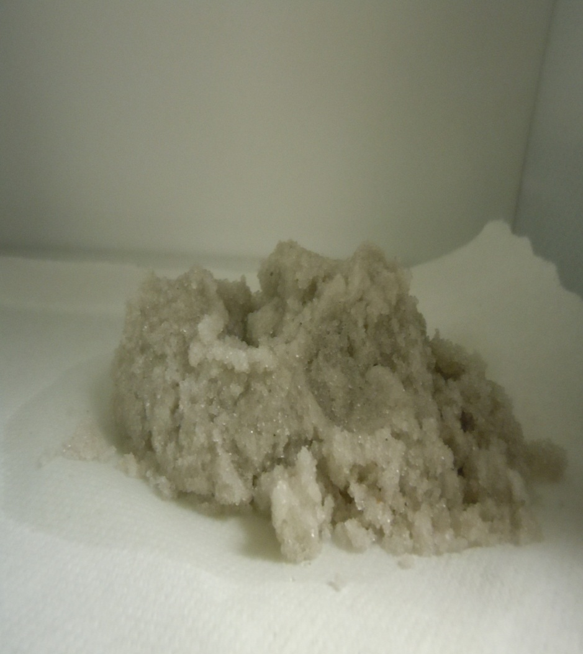
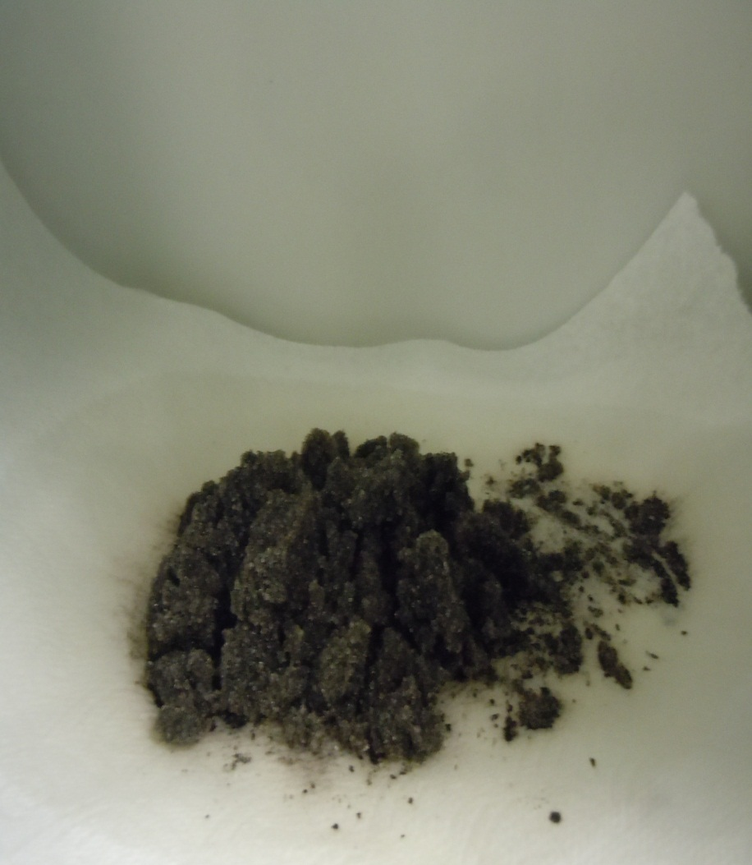
Appearance of Sand after Foam Displaced ~85% oil
Sand after foamed in the absence of oil
Sand after foamed in the presence of oil

Slide 20
Rhodia A (Sea water) in the presence of oil
Equal amounts of oil and surfactant mixed
Relaxation time with oil ~ cannot be established from available data
Relaxation time without oil ~ 0.11 seconds (Maxwell fit)

Slide 21
    III. Regime of Weak/Strong Foam
      Minimum Pressure Gradient
      Minimum Superficial Velocity

Slide 22
IV. Regime of Weak/Strong Foam
  Testing for minimum-pressure gradient/minimum-velocity for generation of strong foam
  A fresh sand pack was prepared, saturated with brine and displaced it by 0.5% surfactant solution in sea water.
  N₂-surfactant was co-injected from low-to-high and high-to-low flow rate seeking for the value of minimum-pressure gradient to generate strong foam
      A series of higher velocities tests were done at 23 ft/day and above, then reduced back to 17 ft/day.
  Observations: Strong foam became weak immediately after decreasing flow rate to the same value where weak foams were observed-Test results were reproducible-
  Strong foam, very fine-textured, in effluent when flow-rate is 24 ft/ day and above
  Weak foam, very coarse-textured, in effluent when flow-rate is below 24 ft/day.

Slide 23
Effect of Minimum Pressure Gradient for Strong Foam Generation
Below certain velocity(24 ft/day) weak foam only :path from strong-to- weak is reproducible

Slide 24
Minimum velocity for strong foam generation
Overall
IN
OUT
6”
6”
6”
6”
23 ft/day
Tap 1
Tap 2
23 ft/day

Slide 25
Observations
The strength of foam is highest (350 cP)at 80% ( 1 atm) quality when superficial velocity is maintained at 45 ft/day.
Foam seems to be unstable in the presence of oil. Rheogram shows that viscoelasticity is lost when equal amounts of surfactant and oil are contacted.
There is a transition regime from weak to strong foam. This regime appears to be governed by a critical minimum velocity rather than by a minimum pressure gradient.

Slide 26
Future work
Foam minimum velocity at different qualities
Foam stability with dodecane
Rhodia A blend with anionic or cationic surfactant foam
Other viscoelastic betaines

Slide 27
Acknowledgements
Jose Lopez
Dr. Pasquali and Dimtri
Chang Tian
Process on Porous media and Rhodia(Solvay)

Slide 28
QUESTIONS?

Slide 29
Back up slides

Slide 30
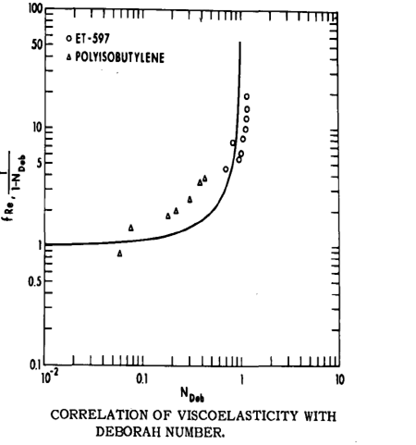
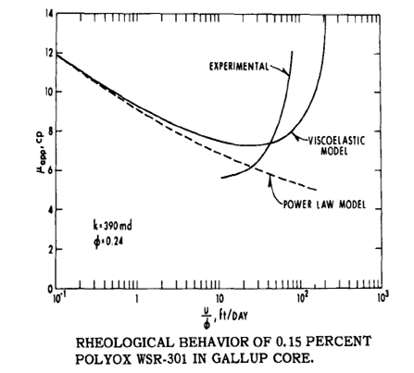
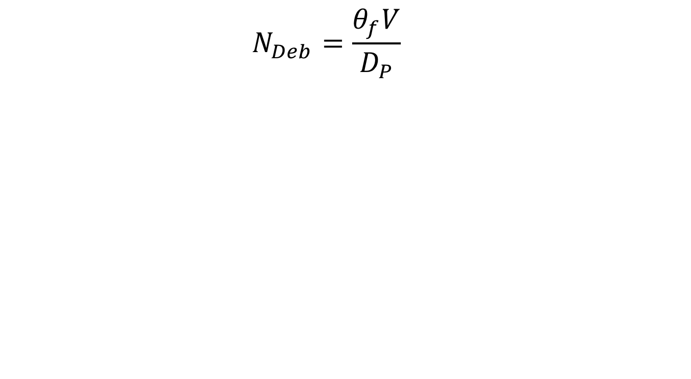
Effect of Deborah number on viscoelastic polymers
  $$N_{Deb}=\frac{θ_{f}V}{D_{P}}$$
G. J. HIRASAKI , G. A. POPE, Analysis of Factors Influencing Mobility and Adsorption
In the Flow of Polymer Solution Through Porous Media, SPE 4026

Slide 31
Prediction of elongational thickening
Rhodia A 0.5wt% Sea Water
Expected elongational hardening
No elongational hardening

Slide 32
Foam quality = 50 % at 1 atm
Total superficial velocity = ~45 ft/day
Overall
IN
OUT
6”
6”
6”
6”
Gas fluctuation
Tap 1
Tap 2
Γ at average pressure= 28%
Liquid rate =2.4cc/min
Gas rate = 2.4sccm

Slide 33
Foam quality = 93 % at 1 atm
Total superficial velocity = ~45 ft/day
Overall
IN
OUT
6”
6”
6”
6”
Tap 1
Tap 2
Γ at average pressure = 91 %
Capillary end effect
Liquid rate =0.3cc/min
Gas rate = 4.5sccm

Slide 34
Foam quality = 80% at 1 atm
Total superficial velocity = 35 ft/day
Overall
IN
OUT
6”
6”
6”
6”
Tap 1
Tap 2
Γ at average pressure= 58 %
Liquid rate =0.72/min
Gas rate = 3sccm

Slide 35
Foam quality = 80 % at 1 atm
Total superficial velocity = ~115 ft/day
Γ at average pressure= 57 %
Overall
IN
OUT
6”
6”
6”
6”
Tap 1
Tap 2
Liquid rate =2.4/min
Gas rate = 9.9 sccm

Slide 36
Minimum velocity continuous foam experiment
Overall
IN
OUT
6”
6”
6”
6”
Tap 1
Tap 2

Slide 37
Minimum velocity
Overall
IN
OUT
6”
6”
6”
6”
Tap 1
Tap 2

Slide 38
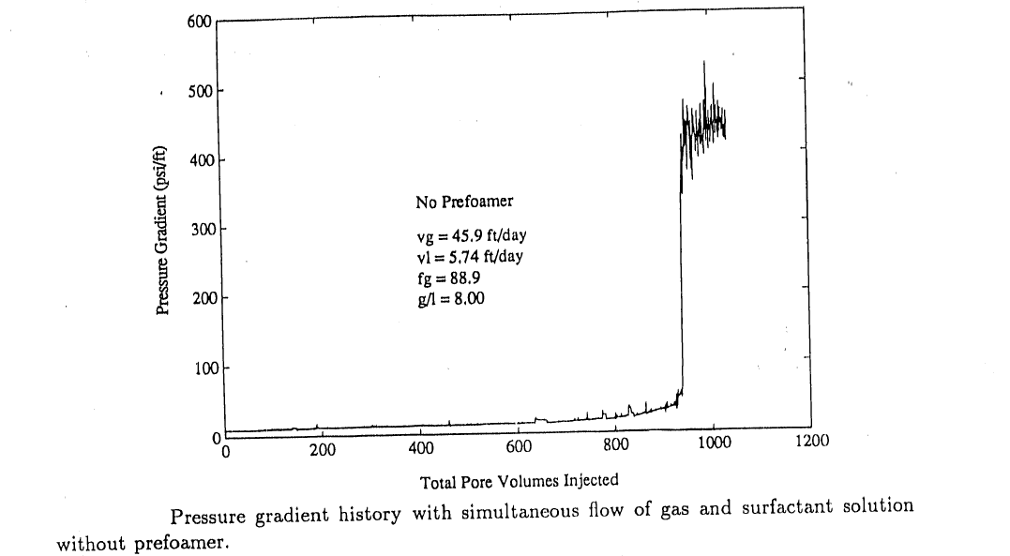
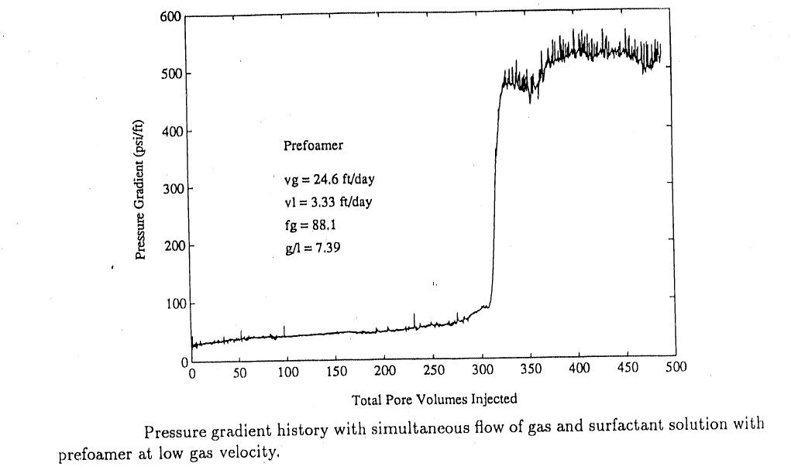
From Literature:
Simultaneous flow of gas and surfactant solution experiments
No prefoamer
Incubation effect
With prefoamer
Baghdikian, S. Y., & Handy, L. L. (1991). Transient behavior of
simultaneous flow of gas and surfactant solution in consolidated
porous media. Topical Report performed under U.S. DOE contract
FG22-90BC14600.

Slide 39
Foam quality =80 % at 1 atm
Total flow rate = ~45 ft/day
80 % foam quality test in a fresh sand pack. The strong foam regime is not observed.
Foam quality =80 % at 1 atm
Liquid rate =0.84 cc/min
Gas rate = 4 sccm

